Slide 1
P300 Speller System for
Brain Computer Interface
PraveenKumar Suthar(15100018)
Prafull Dinesh Parmar(151070025)
Yash Bhushan Barapatre(151070030)
Aditya Manish Samant(151070035)

Slide 2
Abstract
P300 speller for Brain-Computer Interface systems aim to provide a direct communication between computer -machine and human brain, without any muscular activity.
The communication is provided by detecting the presence of P300 Event Related Potentials (ERPs) in the electroencephalogram(EEG) signals, recorded from scalp.
We aim to design a real-time EEG-based communication aid using brain-computer interface (BCI) technologies implementing Machine Learning(ML) and using Enobio headset as an EEG Input system.

Slide 3
Abstract
We present a method to analyze the EEG data for P300 speller system using Support Vector Machines (SVM) classification technique.
Using the proposed method, we would be able to find a correct and faster solution for the “target character detection” associated with the P300 speller system which makes it suitable for real time analysis .

Slide 4
Introduction

Slide 5
Introduction
Brain-Computer Interfacing (BCI) systems aim to develop a direct communication medium between a user and a computer machine.Using BCI, we can send commands to a computer without any muscular activity.The BCI system involves recording conscious neural electrical activates via electroencephalograms (EEGs) signals, and performing signal processing and pattern recognition activities to detect what user wants to communicate.
Event-Related Potentials (ERPs) are the components of EEG that occur in response to some stimuli. A speller system based on the P300 ERP is commonly known as P300 speller. Here, P300 means a positive going ERP produced after 300 ms of stimulation.

Slide 6
Introduction
If a user is asked to distinguish between two stimuli (presented in a random order), where one of them rarely occurs (the “odd-ball”), then a P300 wave is produced in response, and this phenomenon is known as “odd-ball paradigm”
A visual paradigm based P300 speller system consists of several stages:
Stimulating a subject by presenting a P300 display paradigm matrix
Recording the EEG
Signal preprocessing
Feature extraction
Classification

Slide 7
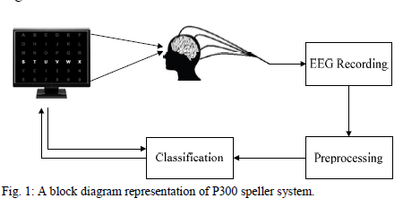
Introduction

Slide 8
The Dataset
Data is collected in different sessions.
Every session is made out of various runs and for every run, a subject is asked to spell a character.
The character matrix is intensified for 100 ms and blank for 75 ms.
For one round there are 12 flashing and for one character the sets of 12 intensifications are repeated 15 times (i.e., each row/column is intensified 15 times and thus there are 12∗15 = 180 total intensifications for single character).
Each repetition is called epoch. so, each character data consist of fifteen epochs.
The EEG data is collected continuously from 8-channels.

Slide 9
The Dataset
The data files generated by the Neuroectric Interface Controller(NIC) are in the ‘.easy’ format
The dataset consists of 10 columns.
The first 8 columns are for the 8 channels of the EEG machine and the remaining 2 columns are used for storing marker and timestamp
The unit of the EEG sample is nano volts and its range is from +400000000 to -400000000 nV

Slide 10
Motivation

Slide 11
Motivation
One of the most significant characteristics of human beings is their capability to communicate. The richness and complexity of communication between people play an important role in relationships.However, direct conveyance of emotions, concepts and thoughts from one brain to another brain is still impossible.
They have to be converted into verbal/written messages, drawings, gestures or other distinguishable expressions.
Typically, written and verbal communications are sent using the throat, mouth and hands, although the expressions are generated earlier in the human brain.

Slide 12
Motivation
However, severely disabled people are unable to use the typical output channels for communication.
So they need effective tools like BCI for effective communication using eye blinks , concentrating on a particular command etc.
The number of potential users for BCIs is high, since there are many people worldwide suffering from long-term or life-long disability .
People are suffering from disease like Amyotrophic Lateral Sclerosis(ALS) which attacks motor neurons in the brain resulting in complete and permanent paralysis.

Slide 13
Motivation
Still, these patients are fully conscious, and have needs, feelings and a deep desire to communicate with others.
BCI technology would be of great help for communicating with such patients
These factors motivates to focus on brain-computer interfaces in this study, and particularly on the P300 spelling paradigm, which has been investigated in several studies due to its importance.

Slide 14
Literature Survey

Slide 15
Survey 1 : L.A. Farwell and E. Donchin
“Talking off the top of your head: toward a mental prosthesis utilizing event-related brain potentials”
This paper describes the development and testing of a system whereby one can communicate through a computer by using the P300 component of the event-related potentials (ERP). There is a display of screen containing 26 alphabets together with some extra symbols and commands which serves as the keyboard or prosthetic device.
It studied 5 healthy volunteers who used the system to communicate a 5 letter word to a computer and the primary purpose was to determine the number of trials and the rate of event presentation that are required to achieve a specific level of accuracy in communication.

Slide 16
Survey 1 : L.A. Farwell and E. Donchin
Four different algorithms were used to compute the scores :
Stepwise linear discriminant analysis (SWDA)
Peak Picking
Area
Covariance
The values obtained from above analyses were then used to determine the letter upon which the subject was focusing attention.

Slide 17
Survey 1 : L.A. Farwell and E. Donchin
With this approach the characters can be communicated with reliability at the rate of 1 character every 26 secs , or 2.3 chars/min. This is, of course, rather a low rate for a communication channel.
They also used data from only 5 subjects, so it didn’t perform well across subjects and across sessions.
Link :
http://www.farwellbrainfingerprinting.com/pdf/Farwell-Donchin-1988-Talking-Off-the-Top-of-Your-Head-BCI-brain-computer-interface.pdf

Slide 18
Survey 2 : Rakotomamonjy and Vincent
“BCI Competition 3: Dataset2 -Ensemble of SVMs for BCI P300 Speller”(2008)
Within the context of P300 based BCI , several classification methods, like Support Vector Machine (SVM) or Linear Discriminant Analysis (LDA) have been used.
Several BCI competitions have been organized in order to promote the development of BCI and the underlying data mining techniques and these competitions allows the community to benchmark several classification techniques in an unbiased way. Indeed, the development and test data are provided by BCI laboratories but the truth about test data are not known by competitors.

Slide 19
Survey 2 : Rakotomamonjy and Vincent
This paper presents the algorithm that has provided the best classification performance on the dataset produced by a P300 speller matrix during the BCI 3 competition
It uses P300 speller for recording brain signals and it is based on the oddball paradigm which states that rare expected stimuli produce a positive deflection in the EEG after about 300ms
P300 speller has been introduced by Farwell & Donchin which was published in 1988.

Slide 20
Survey 2 : Rakotomamonjy and Vincent
In this to reduce the influence of signal variability in the classification problem it tries to use an ensemble of classifiers approach which helps to reduce signal to noise ratio and therefore the classifier variability.
A multiple classifier system is developed for each subject and each of the single classifier is a linear support vector machine
They achieved a correct classifier performance of 73.5% and 96.5% for respectively 5 and 15 character sequences and this performance has been evaluated on a test set composed of 200 spelling characters.

Slide 21
Survey 2 : Rakotomamonjy and Vincent
Drawback of this paper is that it provides only offline analysis of the classification algorithms and online capacity has to be verified . Also BCI competition III has only provided datasets from 2 different subjects although from different acquisition sessions.
The algorithm used is not able to handle inter-subject variability since they have only used signals from the same subject for training and testing.This issue of inter-subject learning is important in order to make this BCI speller efficient with a new patient and without the need of a training session
Link: https://ieeexplore.ieee.org/document/4454051

Slide 22
Survey 3: Sourav and Samit
“Score normalization of Ensemble SVMs for BCI P300 Speller” (2017)
Used the same ensemble technique for reducing classifier variability
Since in multi classifier system the averaged score can be affected by one classifier as the score of different classifiers are not in the same level so they used normalization methods to normalized the scores of each of classifiers.
Different Score Normalization Techniques for ESVM are used ,i.e,
Min-Max Normalization
Z-Score Normalization
Median Absolute Deviation (MAD)

Slide 23
Survey 3: Sourav and Samit
Used the BCI Competition 3- Dataset 2 for training and testing and also it contained data about only 2 subjects
The proposed Min-Max normalization achieves 76% on 5 epoch and 97% on 15 epoch compared to initial method of 73.5% and 96.5% and in case of Z-score the accuracy is 75.5% and 97.5% and for MAD it is 76% and 98%.
Drawbacks are that algorithms are tested on the dataset provided by BCI and their performance is not checked on real-time data and also since the dataset contains data about only 2 subjects therefore they perform badly for inter-subject testing . Link: https://ieeexplore.ieee.org/document/8204119

Slide 24
Survey 4: Benjamin Blankertz, Gabriel Curio, Niels Birbaumer and Michael Schröder
“The BCI Competition 2003: Progress and Perspectives in Detection and Discrimination of EEG Single Trials”
This data set, i.e., BCI Competition III Dataset 2, represents a complete record of P300 evoked potentials (three sessions from one subject) recorded with the Wadsworth BCI2000 software using the paradigm described in and originally by Farwell and Donchin.
The objective in the contest was to use the data from two sessions (i.e., 42 characters) to train a classifier and to then predict the 31 characters in the one remaining session.

Slide 25
Survey 4: Benjamin Blankertz, Gabriel Curio, Niels Birbaumer and Michael Schröder
The user was presented with a 6 by 6 matrix of characters. The user’s task was to focus attention on characters in a word that was prescribed by the investigator (i.e., one character at a time). The six rows and six columns of this matrix were successively and randomly intensified at a rate of 5.7 Hz. Two out of 12 intensifications of rows or columns highlighted the desired character (i.e., one particular row and one particular column).
Signals were collected from one subject in three sessions and digitized at 240 Hz. Each session consisted of a number of runs. In each run, the subject focused attention on a series of characters.

Slide 26
Survey 5: Matthias Kaper, Peter Meinicke, Thomas Lingner
“BCI Competition 2003—Data Set IIb: Support Vector Machines for the P300 Speller Paradigm”
In this paper they propose to use SVM(Support Vector Machine) to analyse data from the P300 speller paradigm . They performed a P300 speller paradigm in which a subject is presented a 6x6 matrix, containing 36 symbols. Each row and each column is highlighted once within one trial. If the symbol, to which the subject attends, gets highlighted, a P300 component occurs in the EEG

Slide 27
Survey 5: Matthias Kaper,Peter Meinicke,Thomas Lingner
They trained an SVM algorithm for binary classification in a training set labeled with “1” and “-1” for P300 presence/absence, and computed the value of its discriminant function within a test set, with a high score indicating presence of a P300.
They performed five-fold cross validation on the training set and obtained optimal values for the parameters of SVM.
They achieved an accuracy of 84.5% for separation of P300 from non-P300 signals on training set and after five repetitions on the test set the error rates decreased from 35.5% to 0.0%.

Slide 28
Survey 5: Matthias Kaper,Peter Meinicke,Thomas Lingner
The algorithm was trained and tested on the dataset provided by the BCI laboratories and their is future scope of practical realization with an online scenario.

Slide 29
Literature Survey Conclusion:
Since all these proposed system are based on the offline data that are provided by BCI there is little knowledge about the performance of these same algorithms on real-time EEG data.
Also the dataset provided only consist of 2 or 5 subjects which leads to less accurate results for person not present in the training and testing phase.
So, we aim to work on getting the performance of SVM algorithm on the real-time EEG data and provide good accuracy in the classification results of the target character.

Slide 30
Problem Statement

Slide 31
Problem Statement :
To develop an efficient, real-time system that:
Implements P300 speller
Gathers EEG data at appropriate intervals.
Analyses the EEG signals
Generates accurate output alphabets and numbers
Acts as a word suggestion tool.

Slide 32
Proposed System Design

Slide 33
Proposed System Design :
The P300 speller system will comprise of the following hardware and software modules:
8-channel Enobio EEG machine
NIC software (compatible with the Enobio machine)
P300 Speller GUI
Machine Learning module

Slide 34
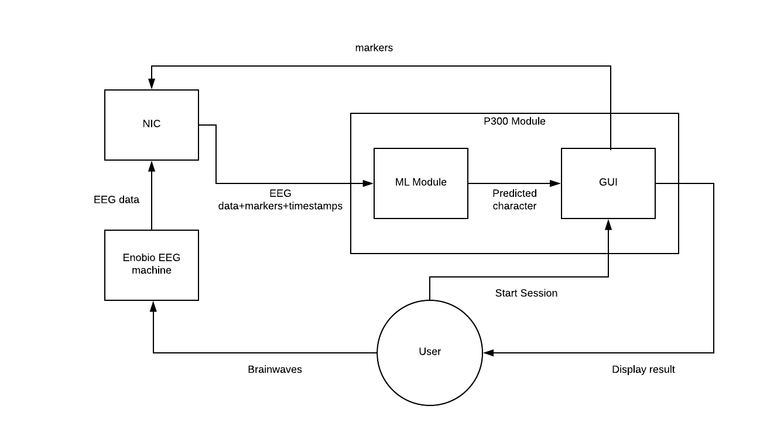

Slide 35
Proposed System Design : Enobio EEG
The Enobio EEG machine is an 8-channel, dry electrode headwear.
The electrode arrangement for our system has been chosen such that the EEG signals pertinent to our application will be recorded.
The Enobio EEG device is capable of recording EEG readings every 2 milliseconds, which will ensure that sufficient data is recorded per epoch.

Slide 36
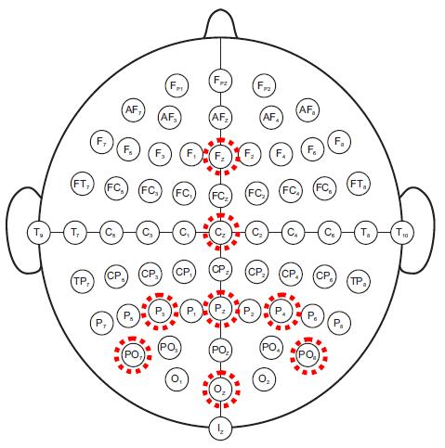
Proposed System Design : Enobio EEG
10-20 system connection for Detecting P300 signals:

Slide 37
Proposed System Design : NIC
Neuroelectrics Instrument Controller(NIC):
NIC is a software developed for the Enobio EEG machine.
It has features that allow us to view the recorded EEG signals as a graph as well as save the EEG readings in a .easy file format along with a timestamp and a marker to denote their significance.
The marker field is used to record the row or column number of a particular intensification during an epoch.
The other fields that are recorded include the timestamp field and one field each for the electrode readings.

Slide 38
Proposed System Design : P300 GUI
The P300 GUI has been written in Python and can be used in two modes: Training and Testing.
It includes a P300 speller display that can intensify the rows and columns of the P300 speller grid.
It connects to NIC using the labstreaminglayer(LSL) library and sends it markers for the row/column that was intensified.
It can also receive EEG data from NIC.

Slide 39
Proposed System Design : ML Module
The data collected by the Enobio EEG machine will be provided as input to an ML Classifier model for training
After the model has been trained then it will be used for real time letter prediction
The proposed model for implementation is the Support Vector Machine(SVM) model

Slide 40
Algorithms

Slide 41
Task
Training by separation of data points representing a spike in the detected EEG brain signals from the usual stable state signals.
Identifying and mapping these surges with the characters on the P300 speller.
Swift prediction of data recorded and sent by the EEG machine.
A Machine Learning model based on Support Vector Machine classifier will be used for this purpose.

Slide 42

Support Vector Machines (SVM)
A non-probabilistic binary linear and non-linear classifier which can be used as a one-against-all classifier for a multi-class classification problem.
An SVM model represents the dataset as points in space, mapped in a way that separate categories are divided by a clear gap as wide as possible.
New data points are mapped onto the same space and predictions are made on the basis of the side of the separator on which they lie.

Slide 43
Why use SVM in this case?
Type of data: Here, based on the type of data, we will require a classifier which produces a non-linear boundary.
Higher accuracy: As compared to traditional classifiers like logistic regression and decision trees, results produced by SVM prove to be more accurate.
Handling outliers: Data recording involves infusion of noise, which can be handled by the SVM parameter ‘C’ doing the job of regularization.
No need of transforming data: Data transformation for better modelling is handled by SVM itself.

Slide 44
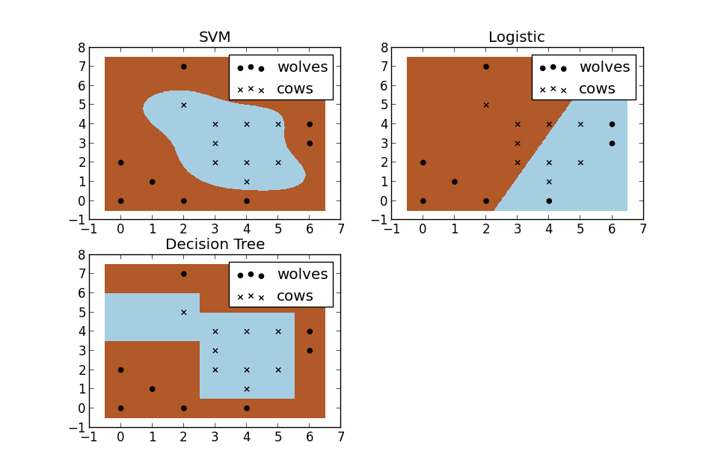
Comparison of SVM with traditional classifiers

Slide 45
Ensemble SVM
Averages out various classifier scores for a particular task to reduce variability produced by each one of them.
Employes one of the two methods:-
Bagging: Training on randomly chosen samples via a bootstrap technique.
Boosting: Training on samples based on their probability distribution, which is updated in proportion to the erroneousness of the sample.
Aggregation of individually trained SVMs to make decisions based on several methods like majority voting and least-squares estimation-based weighting.

Slide 46
References:
A. Rakotomamonjy, and V. Guigue, “BCI competition III: dataset II- ensemble of SVMs for BCI P300 speller,” IEEE Trans Biomed Eng, vol. 55, no. 3, pp. 1147-54, Mar, 2008.
L. A. Farwell, and E. Donchin, “Talking off the top of your head: toward a mental prosthesis utilizing event-related brain potentials,Electroencephalogr Clin Neurophysiol,vol. 70, no. 6, pp. 510-23, Dec, 1988
S. Kundu and S. Ari, "Score normalization of ensemble SVMs for brain-computer interface P300 speller," 2017 8th International Conference on Computing, Communication and Networking Technologies (ICCCNT), Delhi, 2017

Slide 47
References:
4) L. F. Nicolas-Alonso and J. Gomez-Gil, “Brain computer interfaces, a review,” Sensors, vol. 12, no. 2, pp. 1211–1279, 2012.
5) Chaurasiya, Rahul & Londhe, Narendra & Ghosh, S. (2015). An Efficient P300 Speller System for Brain- Computer Interface.
6) S. Xing, R. McCardle and S. Xie, "Reading the mind: The potential of electroencephalography in brain computer interfaces," 2012 19th International Conference on Mechatronics and Machine Vision in Practice (M2VIP), Auckland, 2012.

Slide 48
SUMMARY
P300 speller for Brain-Computer Interface systems aims to provide a direct communication between computer-machine and human brain, without any muscular activity.
We aim to design a real-time EEG-based communication system using brain-computer interface (BCI) technologies implementing Machine Learning(ML) and using Enobio headset as an EEG Input system.
We propose to use the Support Vector Machines (SVM) classification technique.

Slide 49
SUMMARY
Our proposed system would have 4 modules namely: 8-channel Enobio EEG machine, NIC software (compatible with the Enobio machine), P300 Speller GUI and ML module

Slide 50
Conclusion
Literature survey of the topic has been completed.
Requirements have been noted.
System design has been proposed and analysed.
Implementation of the P300 speller GUI is almost complete.
Communication mechanism between NIC and P300 speller GUI has been implemented.

Slide 51
Thank You!

